Slide 1
Variational Inference, VAE, and VGAE
Ji Qi

Slide 2
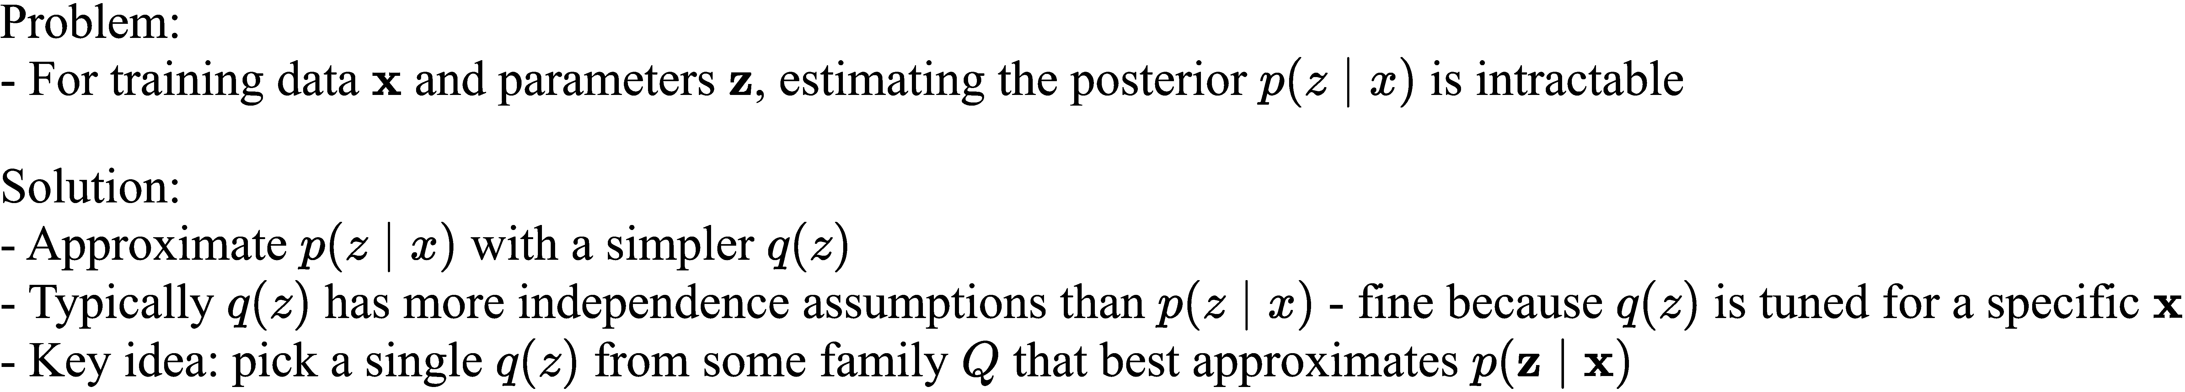
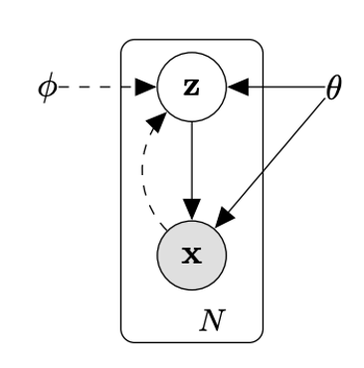
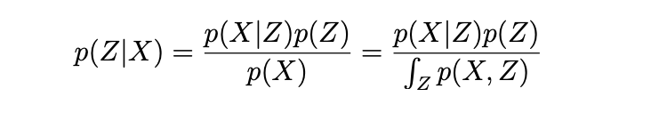
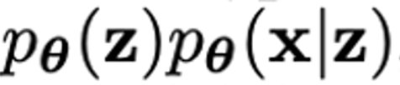
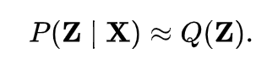
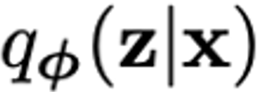
Problem
Solid lines are the generative model:
Dashed lines are the variational approximation

Slide 3
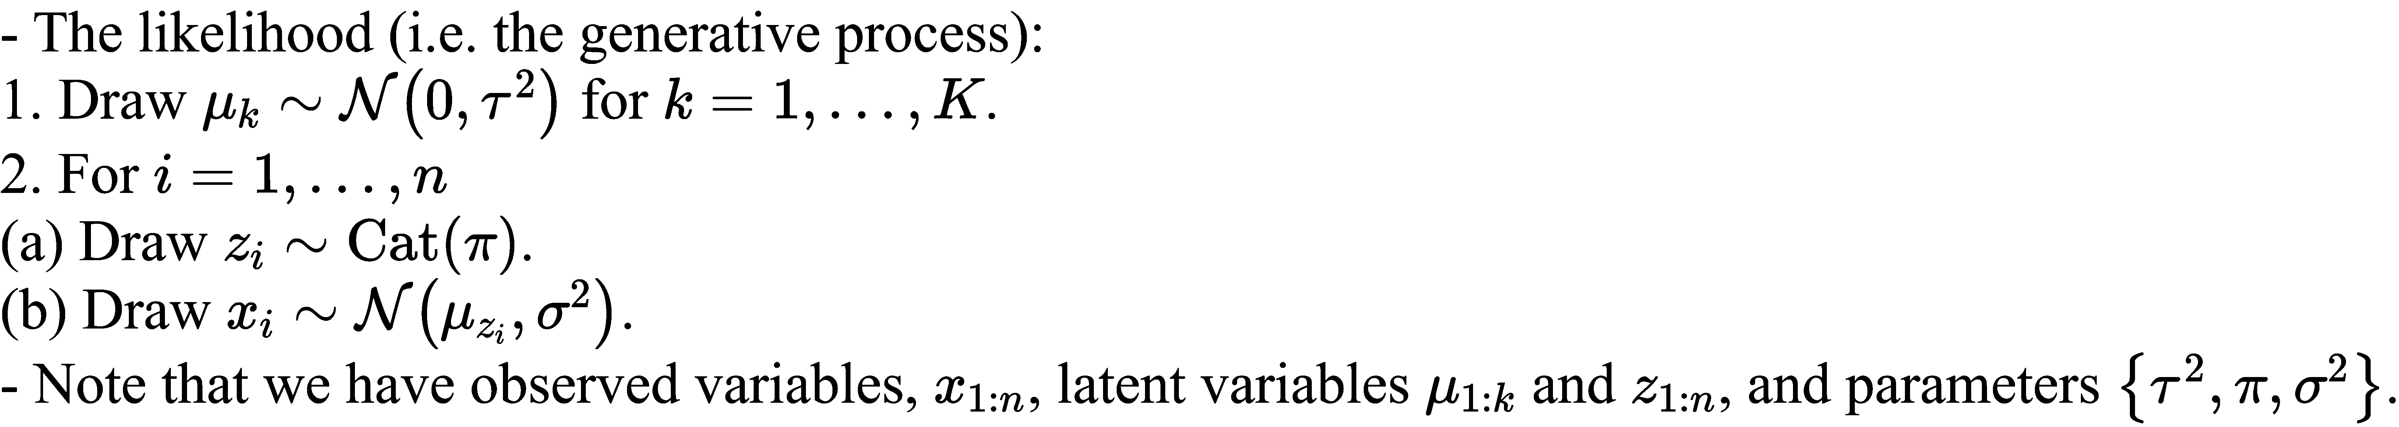
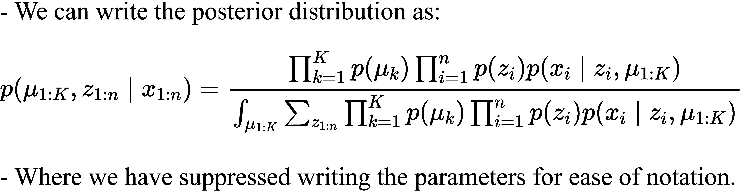
An Motivating Example
Bayesian mixture of Gaussians:

Slide 4
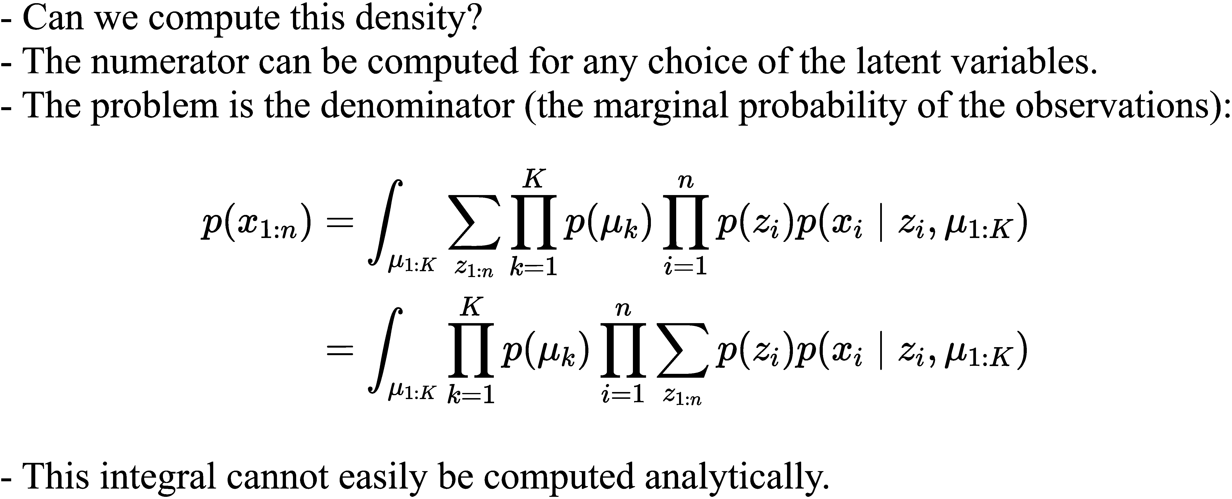
An Motivating Example

Slide 5
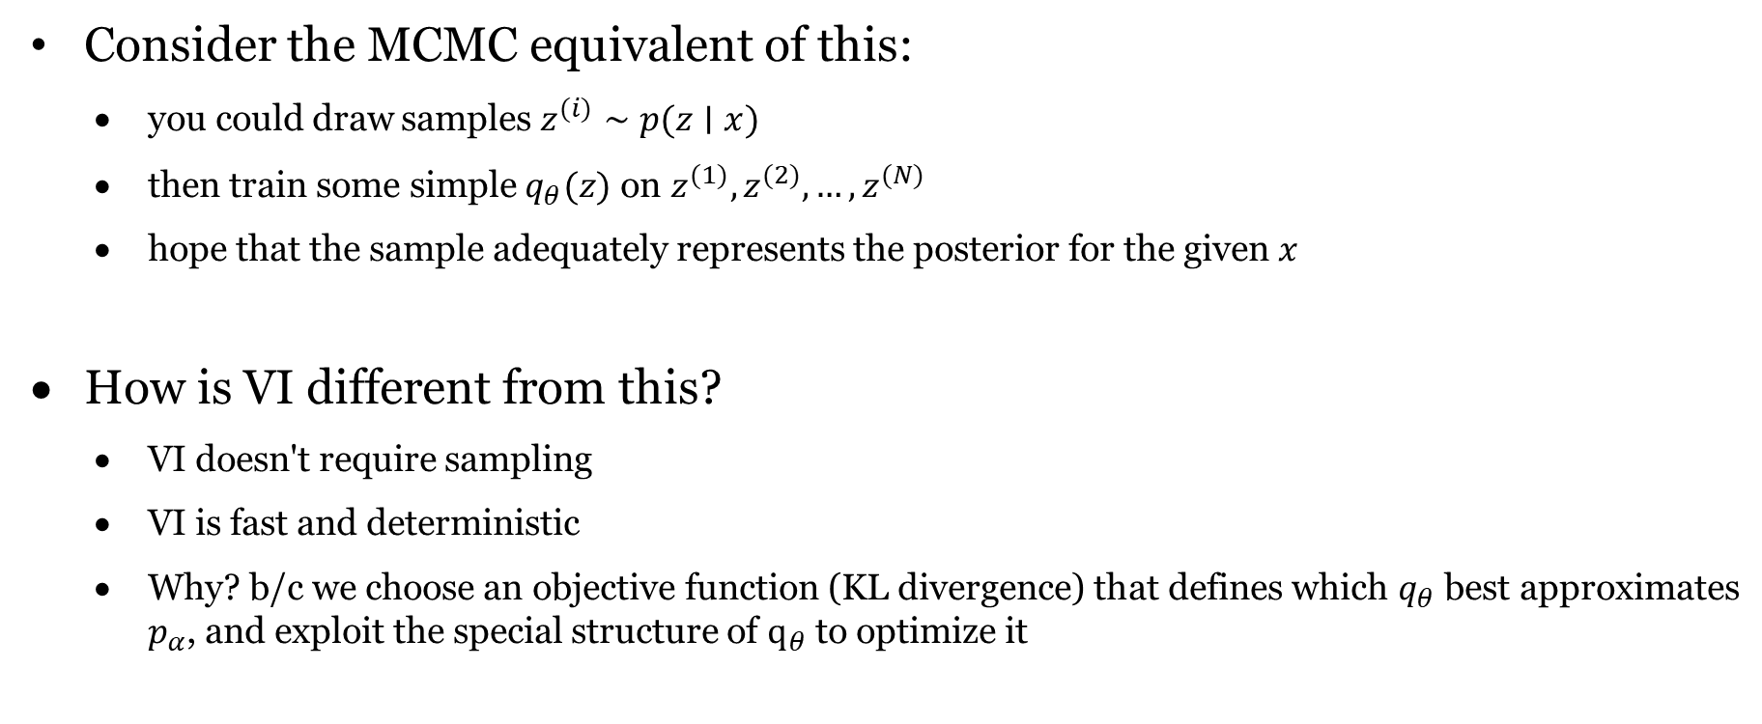
Why choose VI?
Consider the MCMC equivalent of this:
you could draw samples $z^{(i)}∼p(z∣x)$
then train some simple $q_{θ}(z)$ on $z^{(1)},z^{(2)},…,z^{(N)}$
hope that the sample adequately represents the posterior for the given $x$
How is VI different from this?
VI doesn't require sampling
VI is fast and deterministic
Why? b/c we choose an objective function (KL divergence) that defines which $q_{θ}$ best approximates $p_{α}$, and exploit the special structure of $q_{θ}$ to optimize it

Slide 6
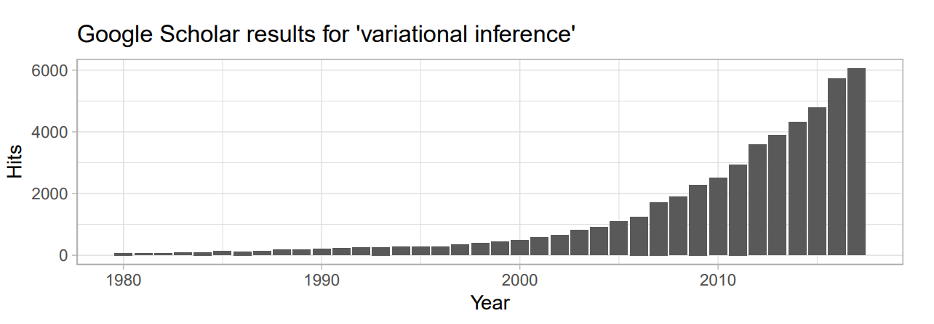
In the literature
Applications (Blei et al., 2017):
Computer vision and robotics (image denoising, tracking, recognition), Natural language processing and speech recognition (topic modelling)
Social statistics (probit models, latent class models, variable selection)
Computational biology (phylogenetic hidden Markov models, population genetics, gene expression analysis)
Computational neuroscience (autoregressive processes, hierarchical models, spatial models, artificial neural networks)

Slide 7
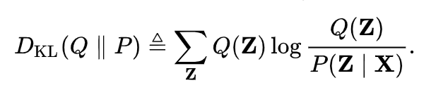
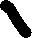
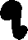


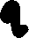

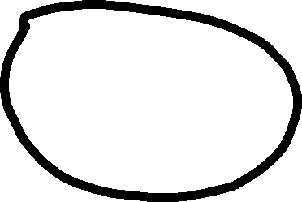
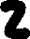
Idea
Minimize KL-divergence:

Slide 8
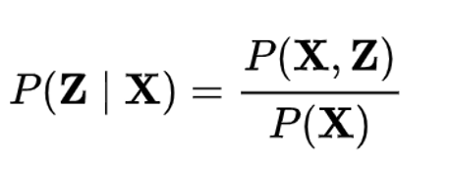
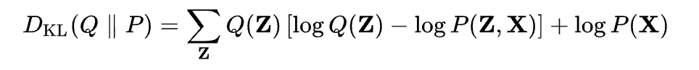
Variational Bayes
Most common form minimizes KL-divergence:
Given that
KL divergence can be written as:
Since P(X) is a constant and Q(z) sums to 1 over all z’s

Slide 9
Variational Bayes Continued
This can be rewritten in terms of expectation over Q(Z):
Rearranging terms to get log P(X) on one side gives:
Here the last term is called the variational free energy
Maximizing variational free energy minimizes divergence this term because log of evidence is fixed
In this sense the variational free energy forms a bound log P(X)>L(Q)

Slide 10
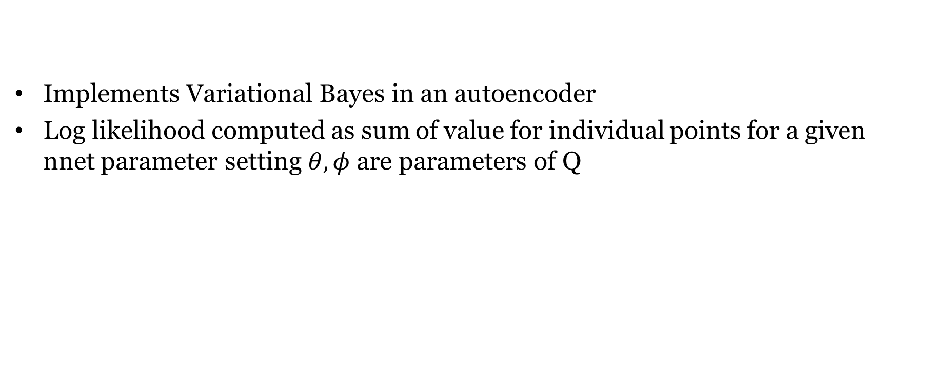
Autoencoding Variational Bayes
Implements Variational Bayes in an autoencoder
Log likelihood computed as sum of value for individual points for a given nnet parameter setting $θ,φ$ are parameters of Q

Slide 11
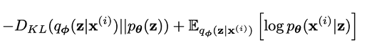
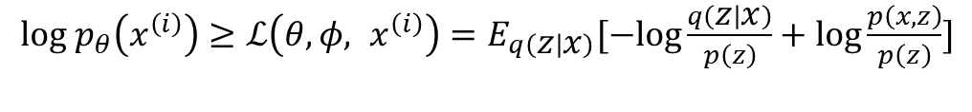
Autoencoding Variational Bayes
Can condition the whole analysis over the z, given a prior on z, p(z)
In a neural network prior p(z) corresponds to the way the latent variables are desired to be shaped
This gives:
The goal is to maximize the RHS.
$log{ p}_{θ}\left(x^{\left(i\right)}\right)≥ℒ\left(θ,φ, x^{\left(i\right)}\right)=E_{q\left(z | x\right)}[−log\frac{q\left(z | x\right)}{p\left(z\right)}+log\frac{p\left(x,z\right)}{p\left(z\right)}]$
$log{ p}_{θ}\left(x^{\left(i\right)}\right)≥$

Slide 12
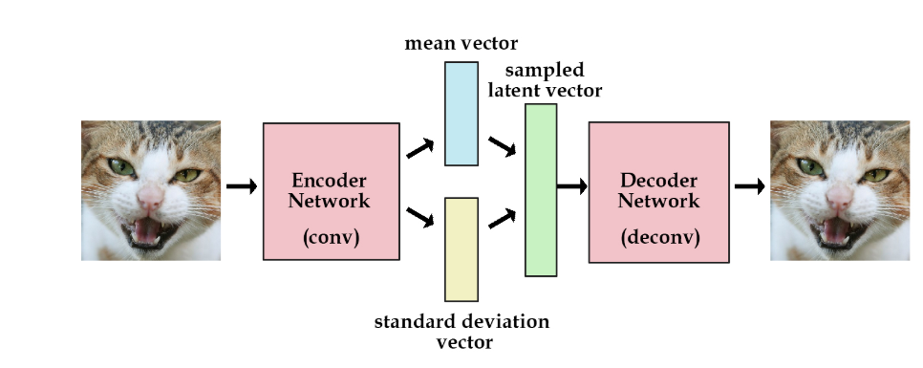
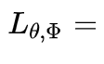
Autoencoding Variational Bayes
Think of the
encoder computing q(z|x)
decoder as computing p(x|z) to reobtain x
p(z) is a prior distribution on z
Maximizing the variational lower bound L(q) of a probability distribution
Two terms in the loss function
Log Likelihood Term
KL Divergence Term

Slide 13
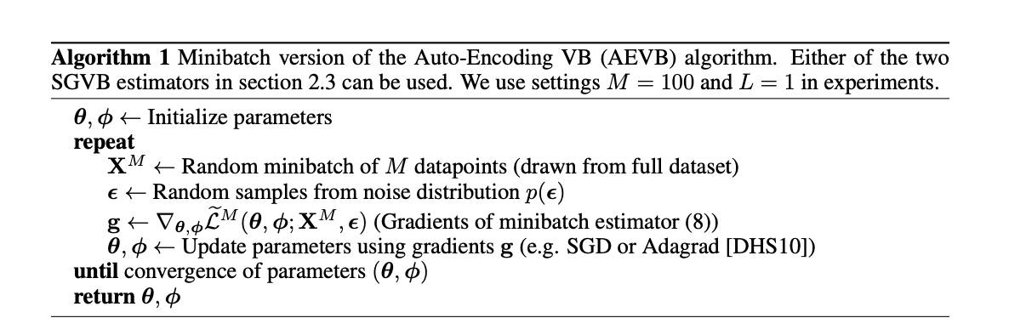
Autoencoding Variational Bayes
VAEs use gradient descent to maximize variational free energy
Use a parametric (neural network parameterized form) Q(Z) and sampling-based estimate of P(Z,X)

Slide 14
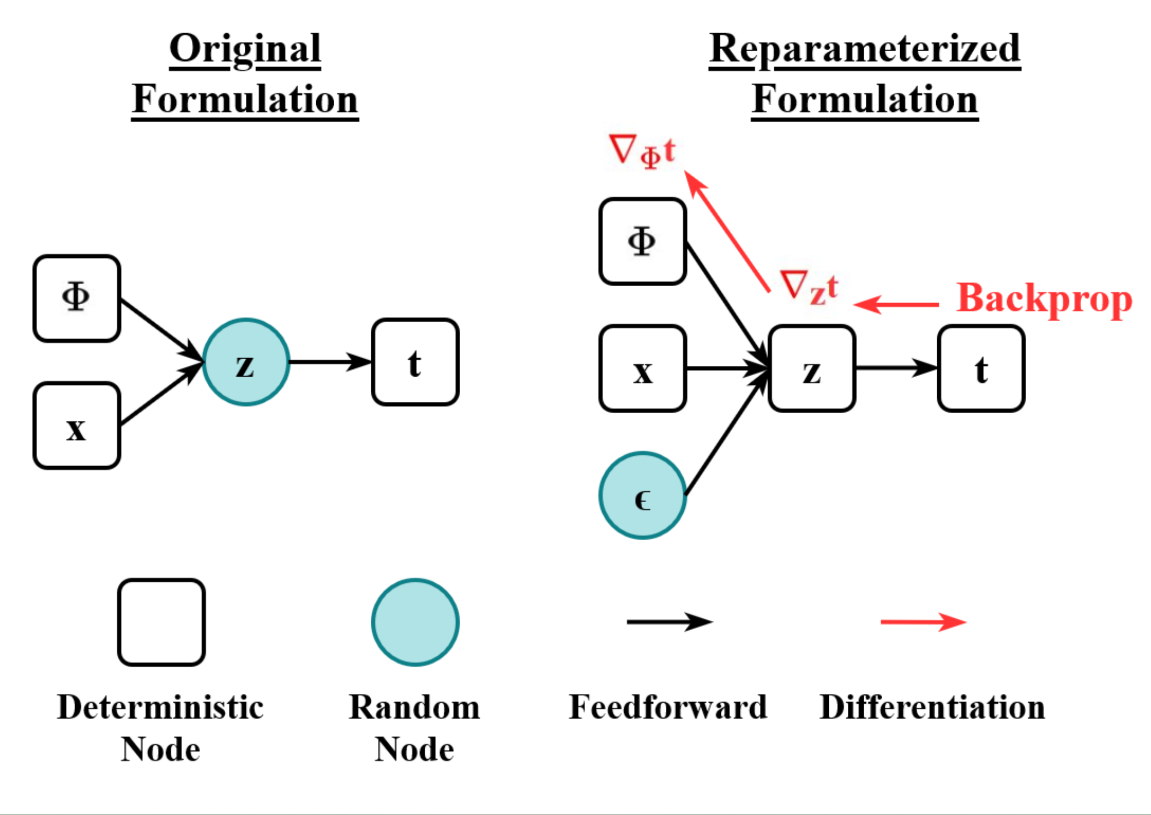
Reparameterization trick
To make the ELBO formulation suitable for training purposes, it is necessary to introduce reparameterization.
Stochastic sampling is the non-differentiable operation through which it is possible to sample from the latent space and feed the probabilistic decoder.
In order to make the application of backpropagation processes feasible, such as the stochastic gradient descent, the reparameterization trick is introduced.

Slide 15
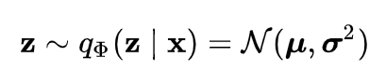
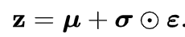
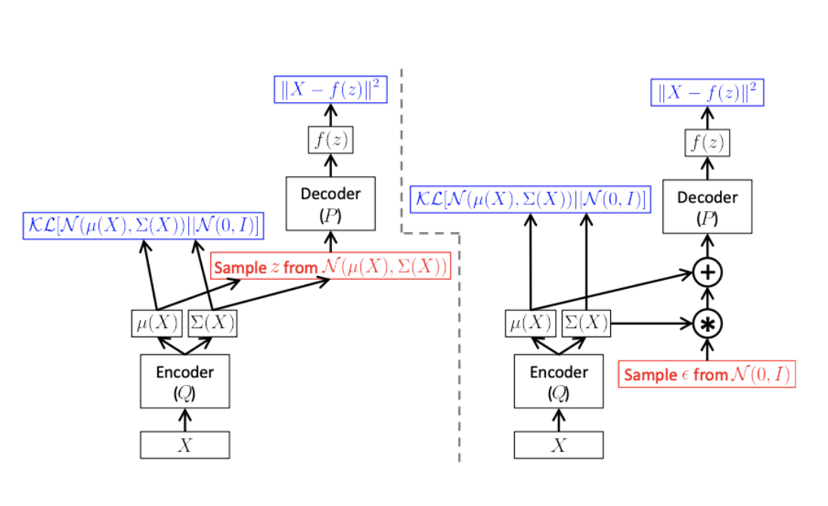
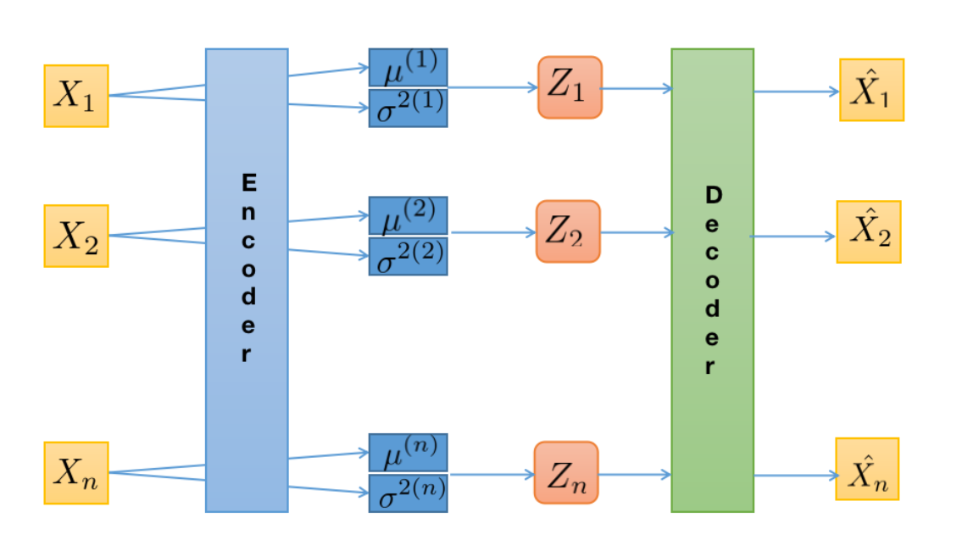
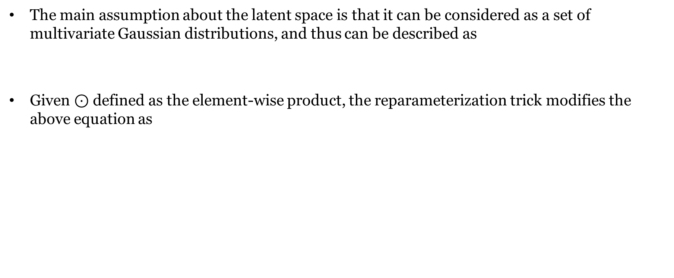
Reparameterization
The main assumption about the latent space is that it can be considered as a set of multivariate Gaussian distributions, and thus can be described as
Given $⊙$ defined as the element-wise product, the reparameterization trick modifies the above equation as

Slide 16
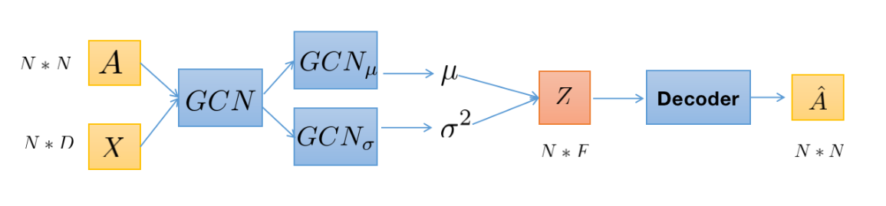
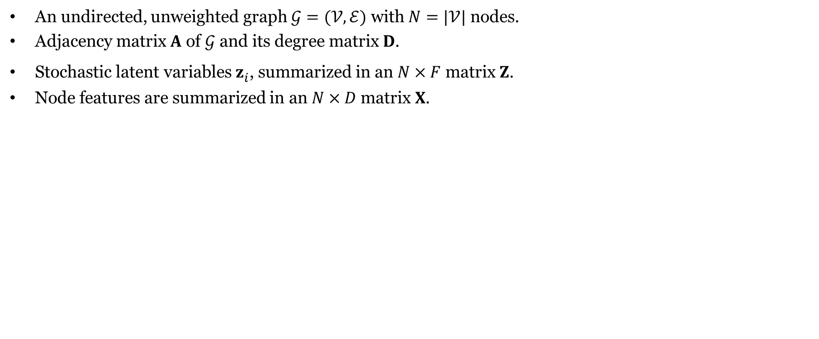
Variational Graph Autoencoder
An undirected, unweighted graph $𝒢=(𝒱,ℰ)$ with $N=|𝒱|$ nodes.
Adjacency matrix $A$ of $𝒢$ and its degree matrix $D$.
Stochastic latent variables $z_{i}$, summarized in an $N×F$ matrix $Z$.
Node features are summarized in an $N×D$ matrix $X$.

Slide 17
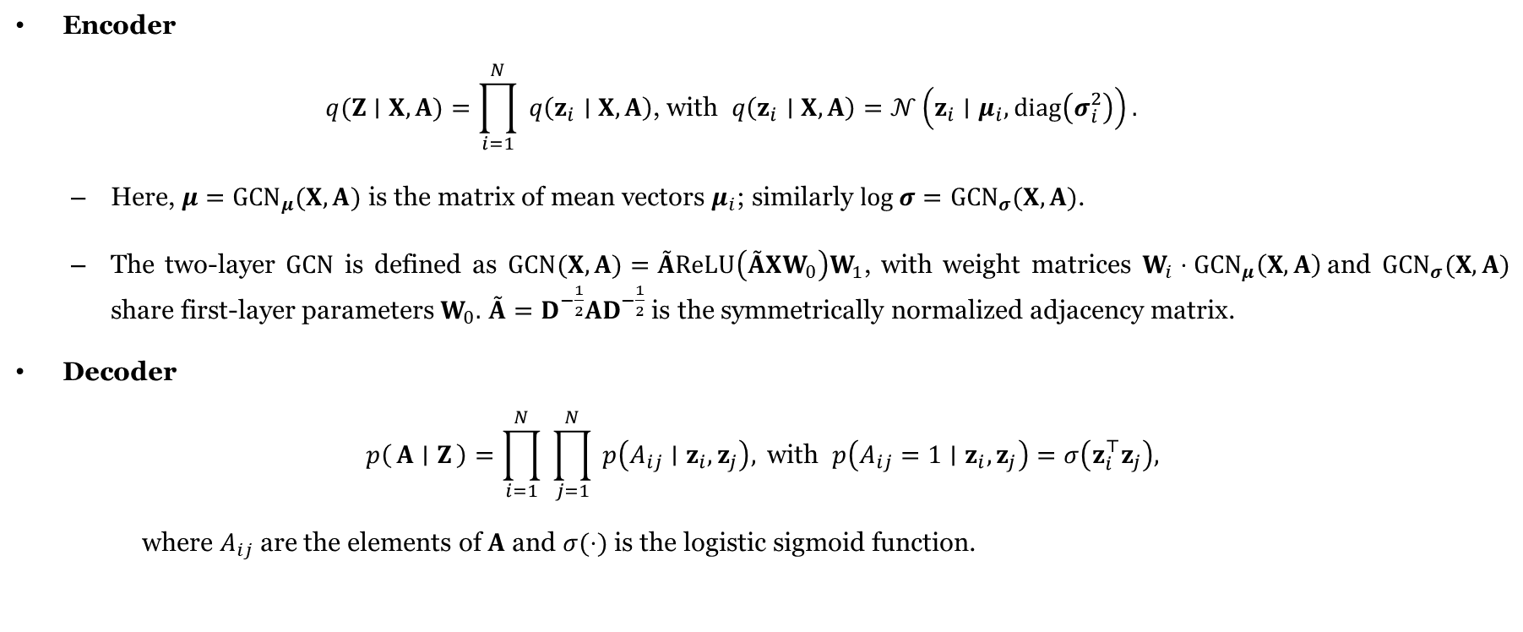
Encoder and Decoder
Encoder
$$q(Z∣X,A)=\prod_{i=1}^{N}{ }q\left(z_{i}∣X,A\right)\text{, }\text{with} q\left(z_{i}∣X,A\right)=𝒩\left(z_{i}∣μ_{i},diag⁡\left(σ_{i}^{2}\right)\right).$$
Here, $μ={GCN}_{μ}(X,A)$ is the matrix of mean vectors $μ_{i}$; similarly $log⁡σ={GCN}_{σ}(X,A)$.
The two-layer $GCN$ is defined as $GCN⁡(X,A)=\overset{˜}{A}ReLU⁡\left(\overset{˜}{A}XW_{0}\right)W_{1}$, with weight matrices $W_{i}⋅{GCN}_{μ}\left(X,A\right)$and ${GCN}_{σ}⁡(X,A)$ share first-layer parameters $W_{0}.$ $\overset{˜}{A}=D^{−\frac{1}{2}}AD^{−\frac{1}{2}}$ is the symmetrically normalized adjacency matrix.
Decoder
$$p\left(A ∣ Z\right)=\prod_{i=1}^{N}{ }\prod_{j=1}^{N}{ }p\left(A_{ij}∣z_{i},z_{j}\right), \text{with} p\left(A_{ij}=1∣z_{i},z_{j}\right)=σ\left(z_{i}^{⊤}z_{j}\right),$$
where $A_{ij}$ are the elements of $A$ and $σ(⋅)$ is the logistic sigmoid function.

Slide 18
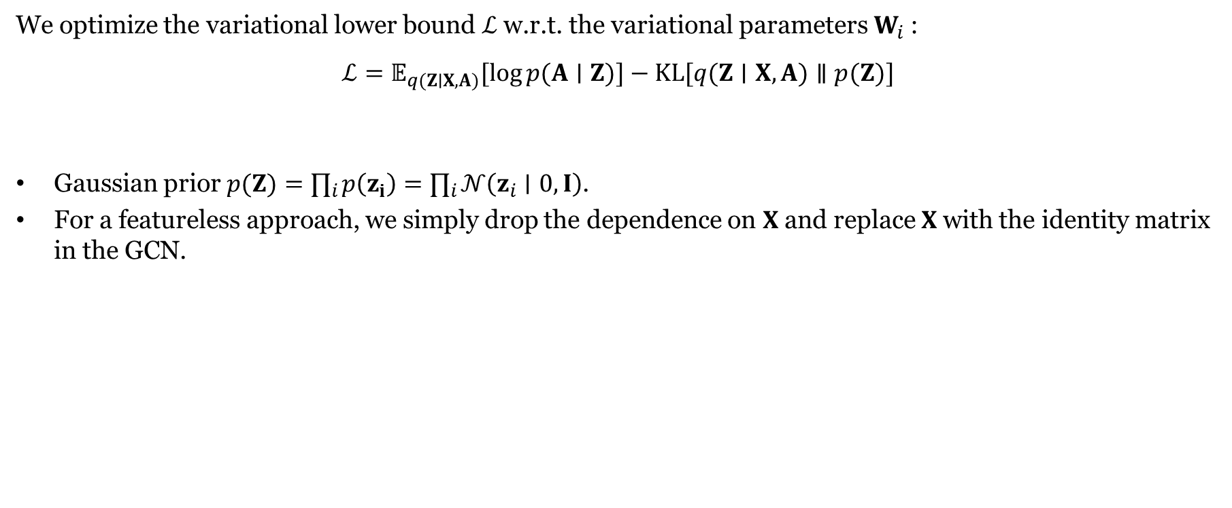
Learning
We optimize the variational lower bound $ℒ$ w.r.t. the variational parameters $W_{i}$ :
$$ℒ=𝔼_{q(Z∣X,A)}[log⁡p(A∣Z)]−KL[q(Z∣X,A)∥p(Z)]$$
Gaussian prior $p(Z)=∏_{i} p\left(z_{i}\right)=∏_{i} 𝒩\left(z_{i}∣0,I\right)$.
For a featureless approach, we simply drop the dependence on $X$ and replace $X$ with the identity matrix in the GCN.

Slide 19
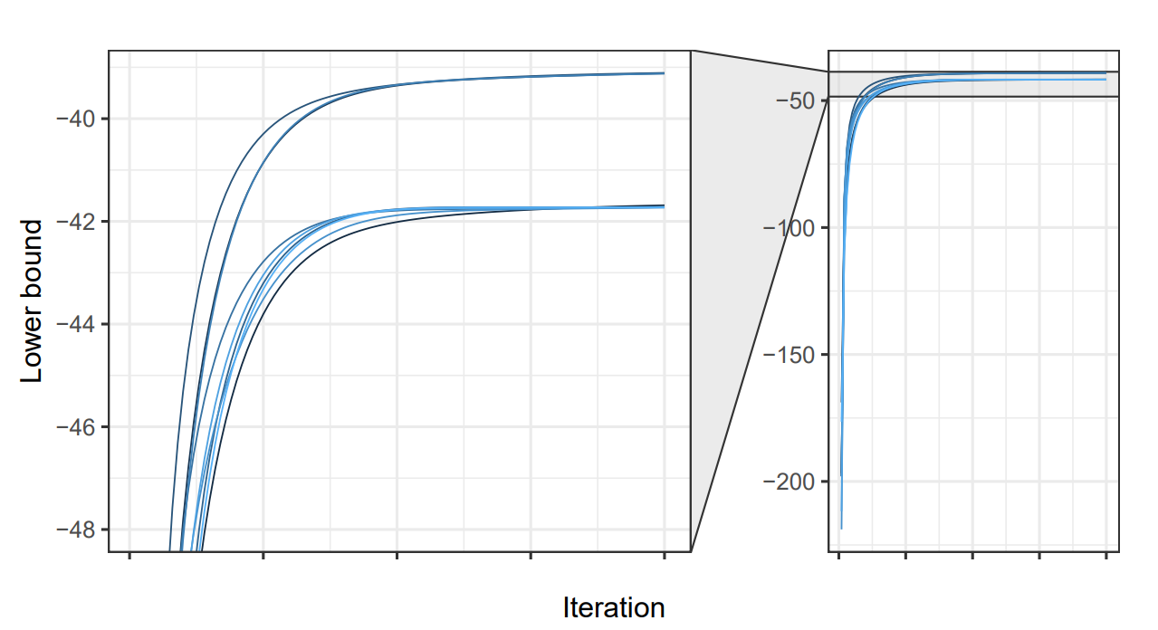
Discussion
VAE only guarantees converges to a local optimum.
Multiple local optima may exist.

Slide 20
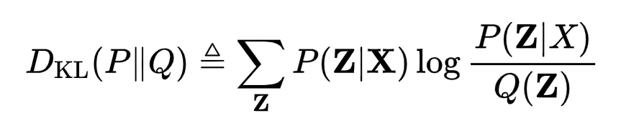
Discussion
Back to KL divergence:
KL(Q||P) is large when P(Z|X) is close to zero, unless Q(Z) is also close to zero (zero-forcing).
What about other measures of closeness?
For instance,
This gives the Expectation Propagation (EP) algorithm.
It is zero-avoiding, because KL(P||Q) is small when both P(Z|X) and Q(Z) are non-zero.

Slide 21
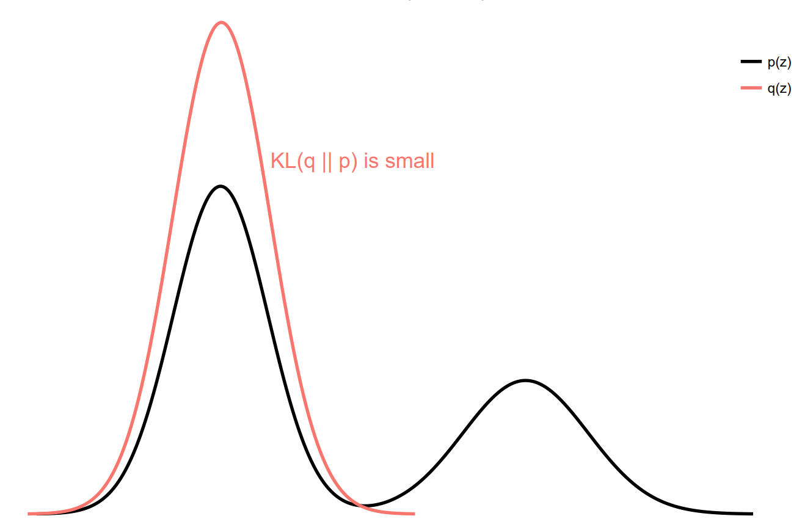
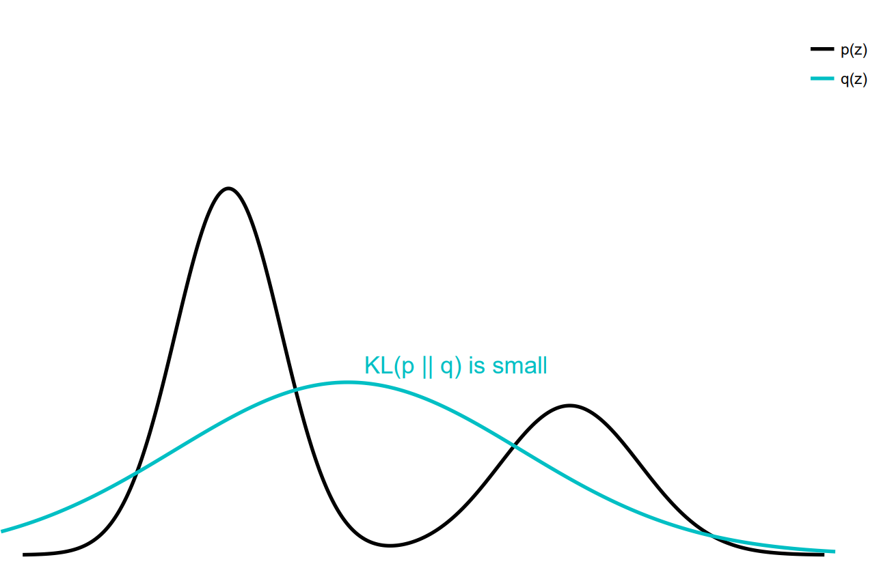
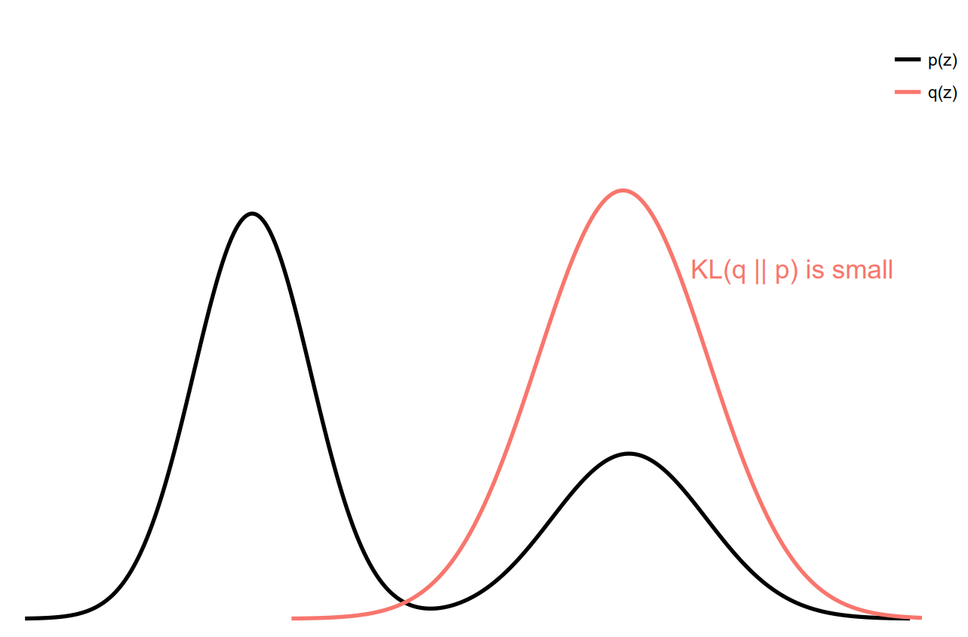
Discussion
Zero-forcing
Zero-avoiding

